Slide 1
Ammonium summary

Slide 2
Protocol
Bring all samples, standards, and WR to room temperature.
Turn off the lights during reagent spiking.
Put BF standard in the dark with samples WITHOUT adding WR. This will be your reagent blank.
Add 2.5 ml aged WR to each sample/standard for 10ml sample . Invert 5 times and store in the dark. Repeat for all.
Incubate samples and standards at room temperature in the dark⁴ 2-8 hours. It is possible to read the samples up to 60 hours after spiking, but the fluorescence, and therefore the sensitivity of the method, decreases after 8 hours.
Turn the fluorometer on a few minutes before (15mins) running samples and check that the excitation and emission wavelengths are set correctly. For turner set up right module (UV) and change setting to Lid start on
Rinse the 1 cm cuvette with MQ.
Add 2.5 ml WR to the BF sample, transfer to the cuvette, and read immediately.
Use a disposable pipette to transfer each standard and sample to the fluorometer. It is not necessary to rinse the cuvette between samples unless you have just read a very high value.
Read one set of standards at the beginning of the run, read the samples, and then read the last set of standards. This way you can correct for instrument drift.
After you are done running samples, rinse the cuvette with MQ. Turn off fluorometer.

Slide 3
For all the following data (unless stated):
  All sample were incubated with Working reagent (WR) for 4 hours
  All sample were treated with 0.2x WR of final volume (sample + WR). e.g for 10ml sample, 2.5ml of WR is added – 0.2 X 12.5ml = 2.5ml
  All sample and standard curve were ran in technical duplicate (ran on machine twice) and the Background Fluorescent was ran in technical triplicate

Slide 4
Ammonium – Fresh vs Frozen

Slide 5
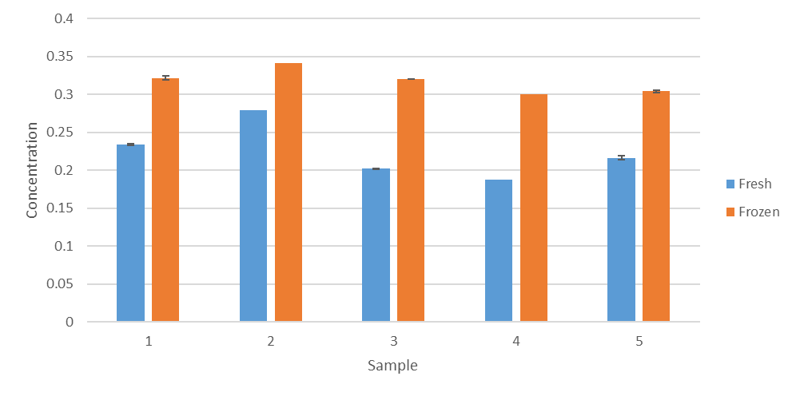
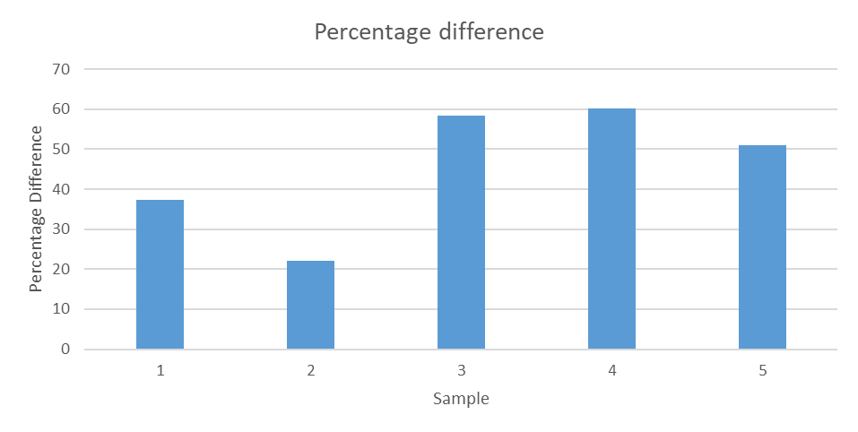
Water from concrete beach was collected in 5 different 50ml falcon tubes.
Tube were rinse
Working reagent was added within the hour of collection
Sample were frozen at -20, and re-ran 3 day post initial experiment
Frozen sample had an average of 45 % difference (range from 20% to 60%)
Standard curve for Frozen had an R² = 0.999
Standard curve for Fresh had an R² = 0.992

Slide 6
Ammonium – Fresh vs Fridge

Slide 7
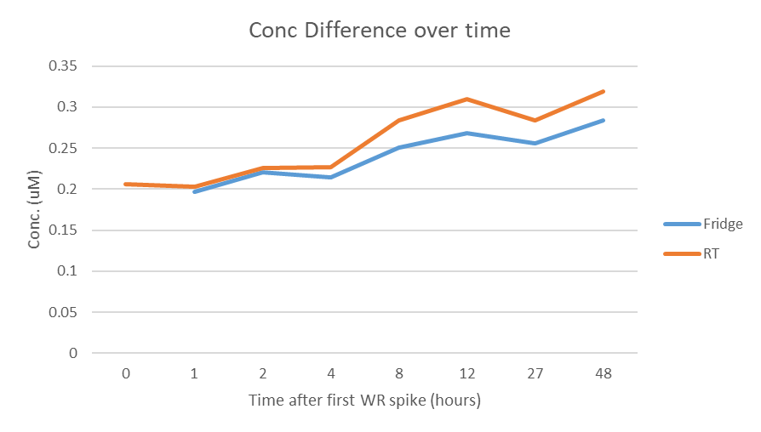
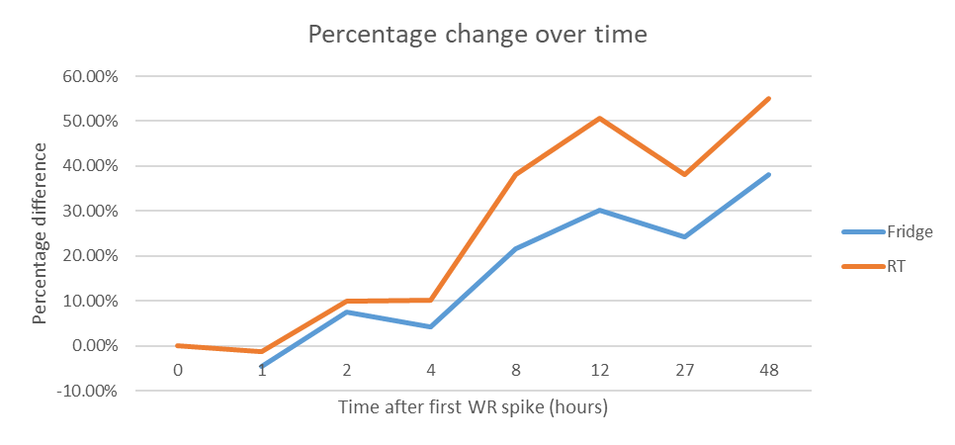
Water from concrete beach was collected in 2L Bottle – at 08.22
Bottle was rinse with sea water before final sample taken
5 rep of 10ml was taken and WR were added – at 08.30 (T0)
The rest of 2L sample was spilt into 2 x 1L sample, one kept at RT (in the dark) and one kept in the fridge
5 rep of 10ml were taken from RT and fridge at 1, 2, 4,8 and 12,27 and 48 hour intervals.
Standard curve had an R² = 0.99

Slide 8
Ammonium – Old opa vs new opa

Slide 9
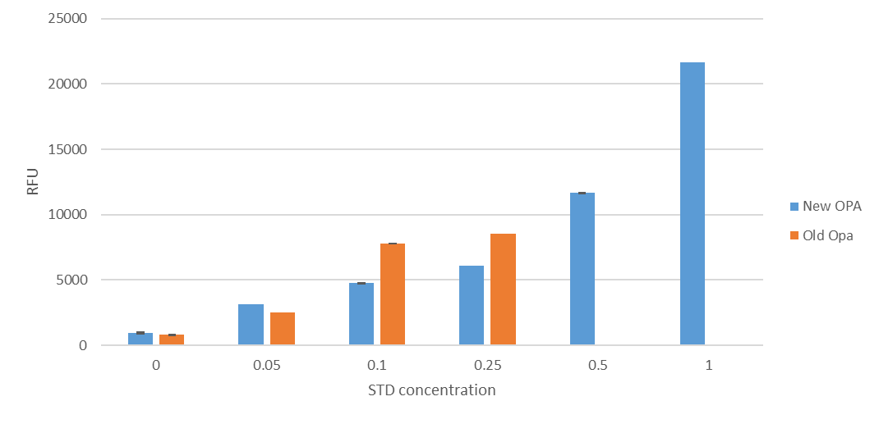
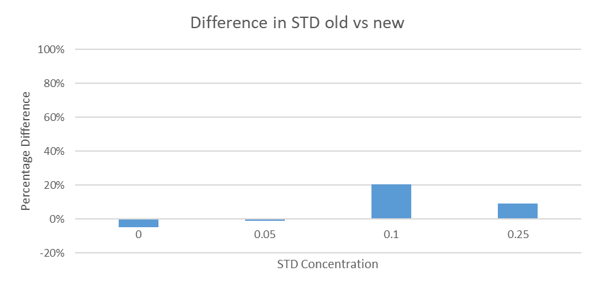
Std was measured using new OPA made 09-nov-2020 vs std made using old opa made ~ August 2020
Same stock was dilute to make the standard
Same matrix was used to make standard
Old OPA only had enough for 4 standard points
Large difference at 0.1uM
Recommend replacing after 2 month.
Standard curve for New had an R² = 0.99
Standard curve for old had an R² = 0.76

Slide 10
Ammonium – Standard curve over time

Slide 11
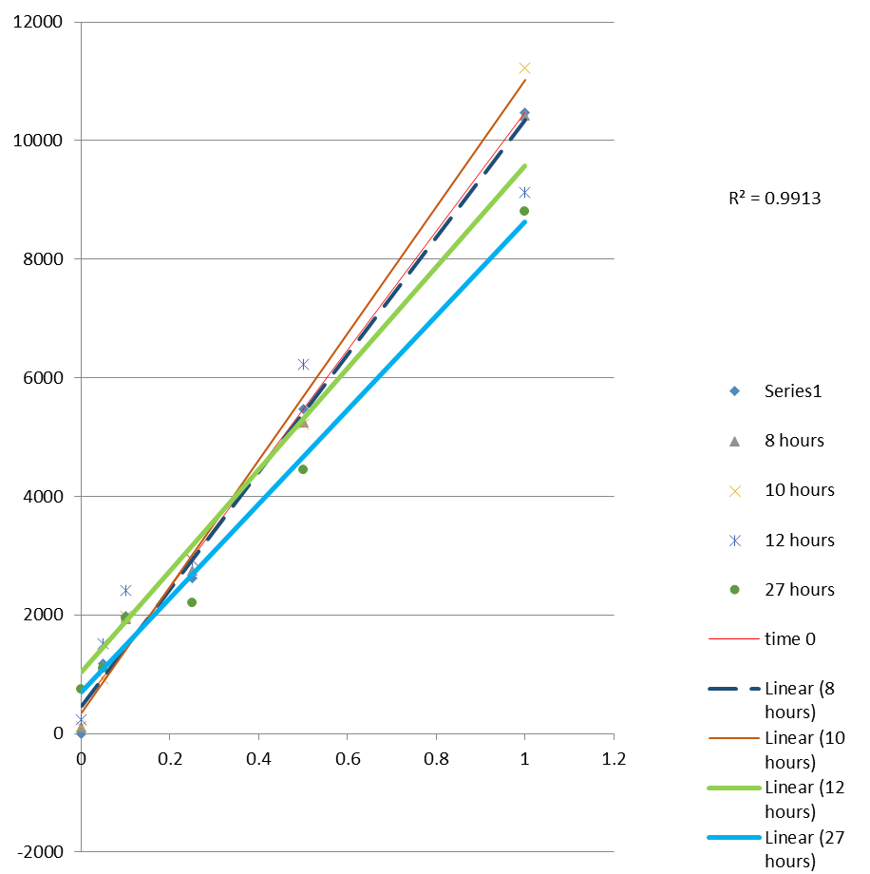
Std was measured using new OPA made
Std was kept in dark at RT
For follow up standard only one rep was taken to save standard
Recommend using a new standard after 8 hours as there is drift from the initial after that period of time.
Test – keeping the std in fridge
Standard curve for New had an R² = 0.99

Slide 12
Ammonium – volume analysis in cuvette

Slide 13
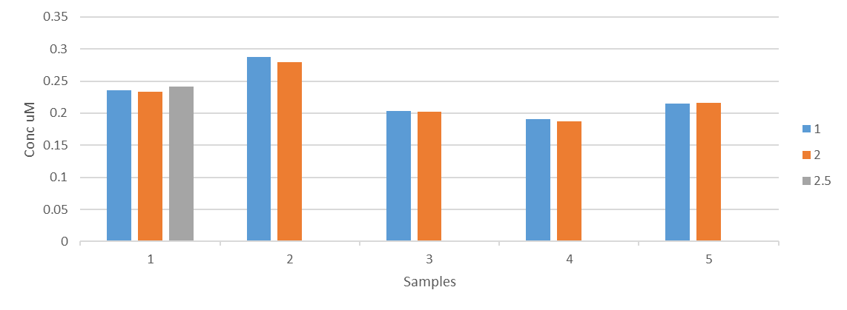
Water from concrete beach was collected in 5 different 50ml tubes.
Either 1ml, 2ml, or 2.5ml sample were added to the cuvette.
No difference between different amounts
Standard curve had an R² = 0.9993

Slide 14
Ammonium – BATs run

Slide 15
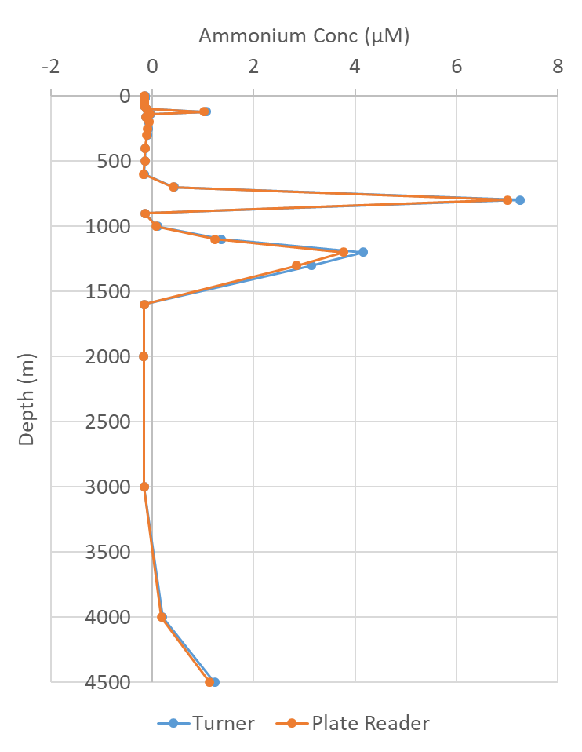
Turner vs plate reader
10364 was ran on turner then sample were ran on plate reader
Separate background fluorescent samples were taken for each machine, otherwise all the sample were same

Slide 16
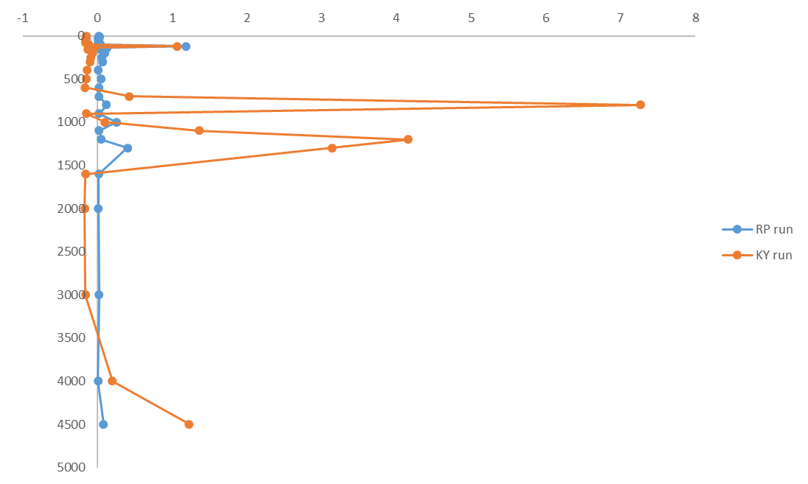
RP vs KY
10364 run, initial done by KY
RP did a repeated run several day post (sample were returned to the -20 freezer after first run)

Slide 17
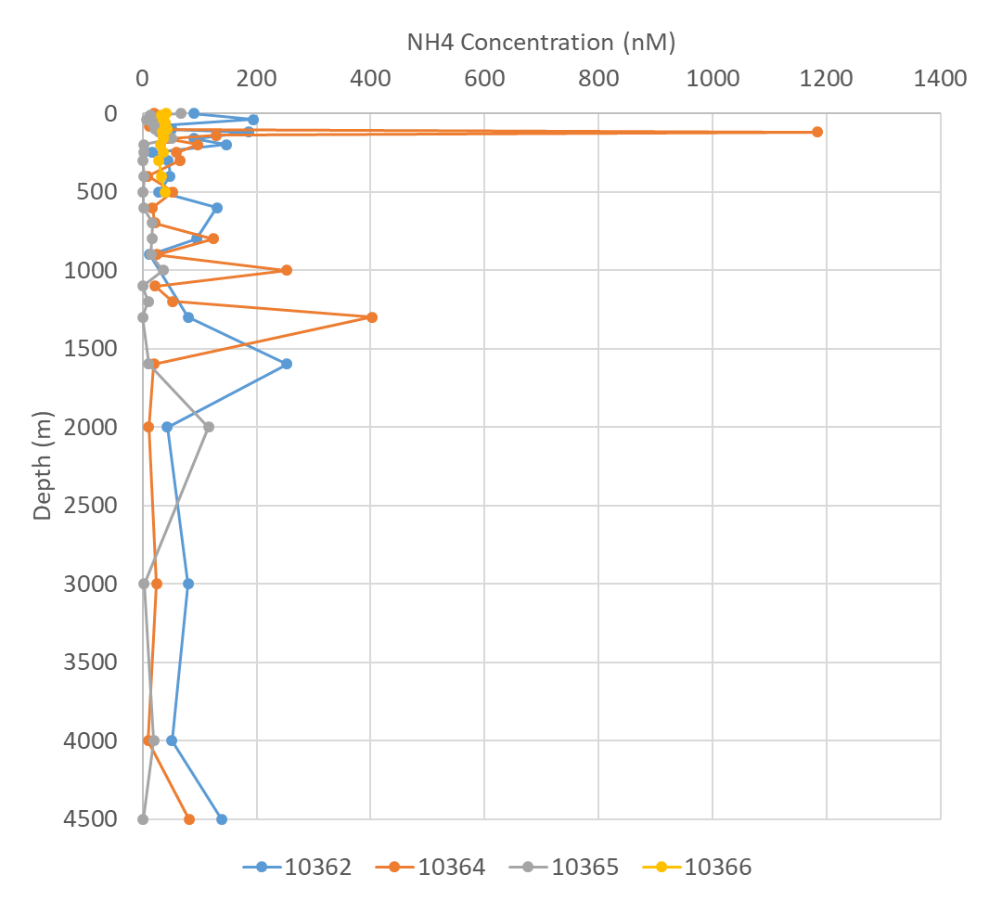
Several BATS profile ran.

Slide 18
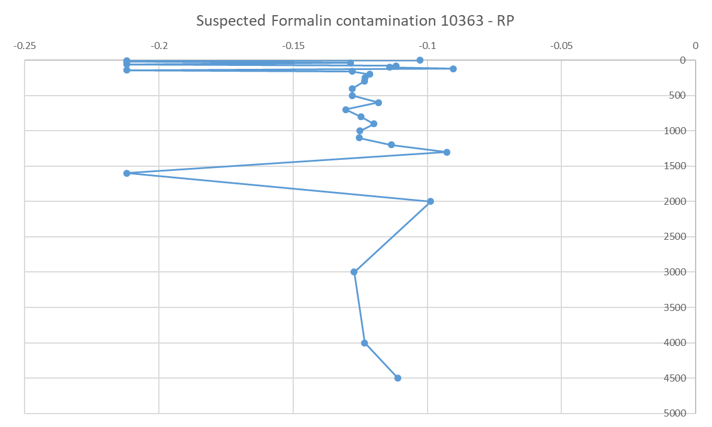
Potential Formalin contamination
10363 had below the standard limit (all values were negative after BF correction)
RP smelt formalin, believe that a potential mix up between Bacteria and NH4 sample?
R2 of Standard = 0.995

Slide 19
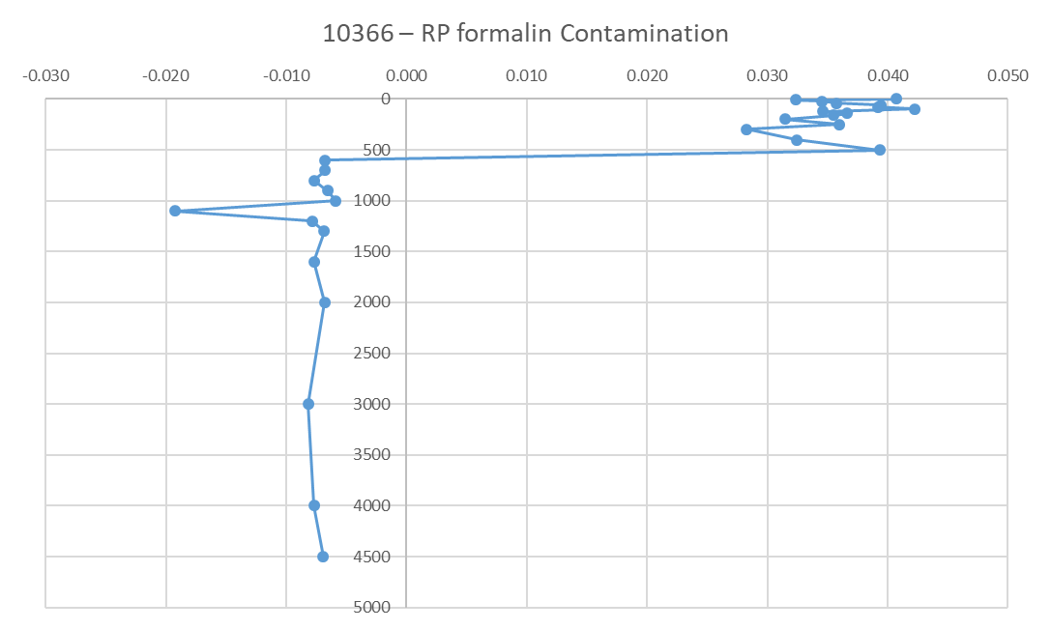
Potential Formalin contamination pt.2
10366 had below the standard limit (all values were negative after BF correction) for several 10366 deep sample depth.
RP smelt formalin, believe that a potential mix up between Bacteria and NH4 sample?
R2 of Standard = 0.998

Slide 20
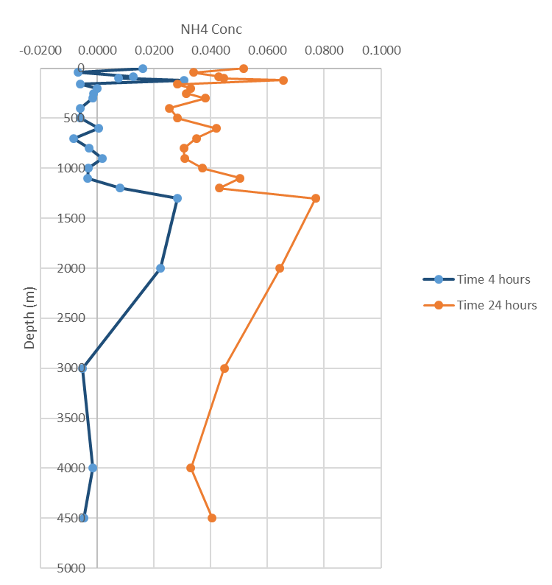

Incubation pt.1
4 hours vs 24 hours
R2 of Standard =

Slide 21
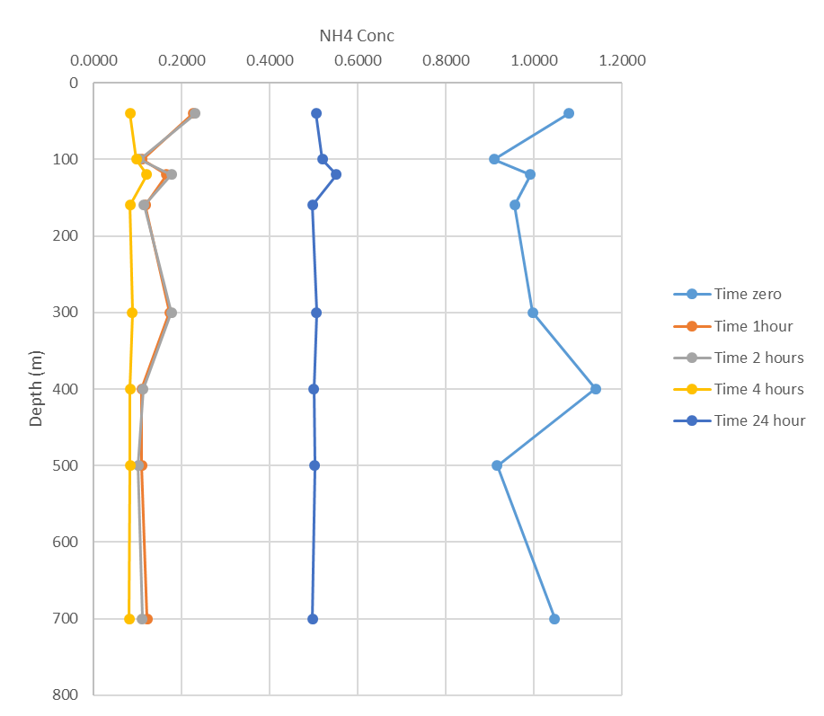
Incubation pt.1
Multi time points
R2 of Standard = 0.998

Slide 22
Next step
Fresh vs frozen – Bats profile

